Slide 1
Steiermark Convention Making meetings a delight
The Official Convention Bureau of
Styria –
„The Green Heart of Austria“
steiermark.com/Convention

Slide 2
Styria The Green Heart of Austria
A tourist brand for more than 50 years
Over 60% of the state's surface covered by forest
Sustainable by nature
steiermark.com/Convention

Slide 3
Steiermark Accessibility

Slide 4
Steiermark Location & directions

Slide 5
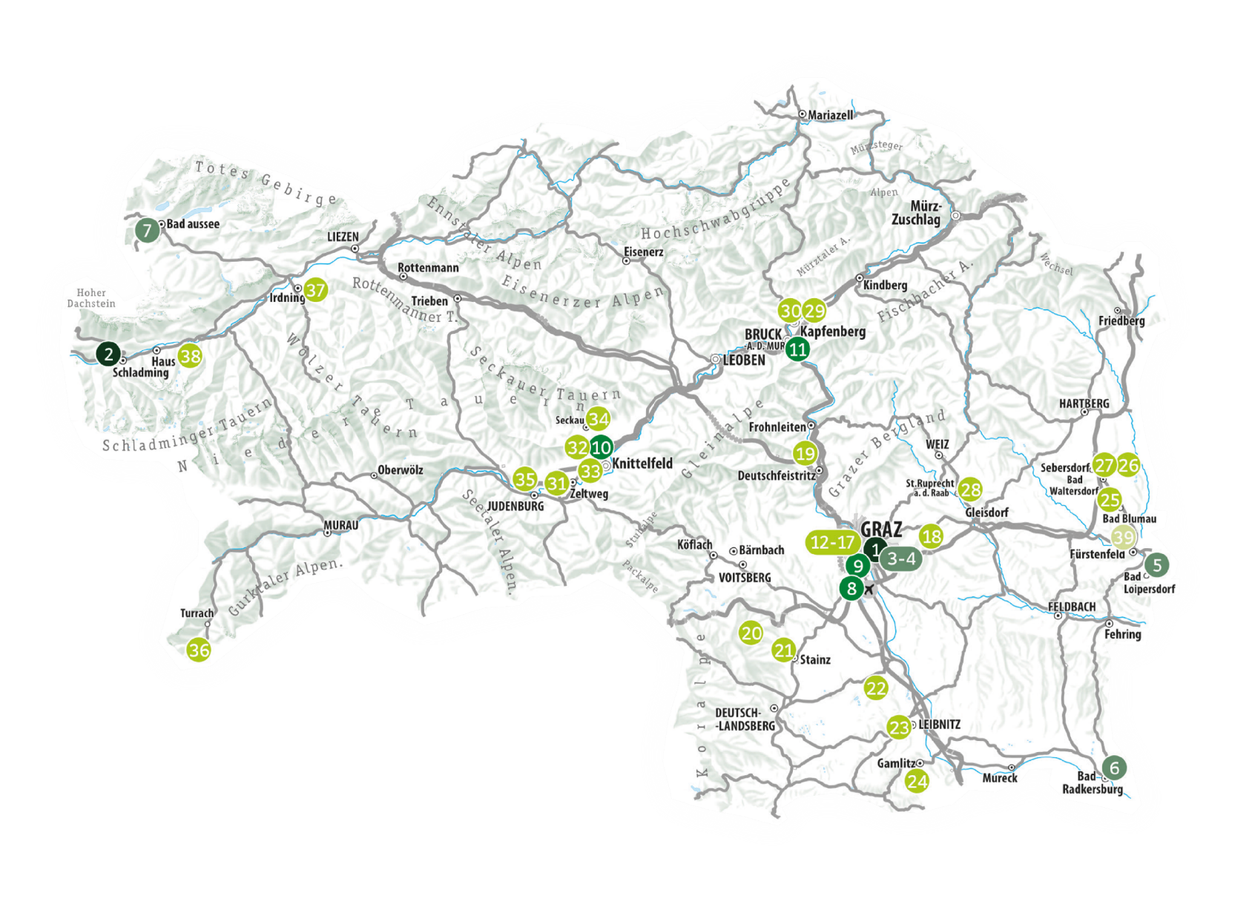
Steiermark Regions & meeting locations

Slide 6
Styria Worlds of experience
Eating & drinking
Nature & exercise
Wellness & regeneration
Culture in town and country
steiermark.com/Convention

Slide 7
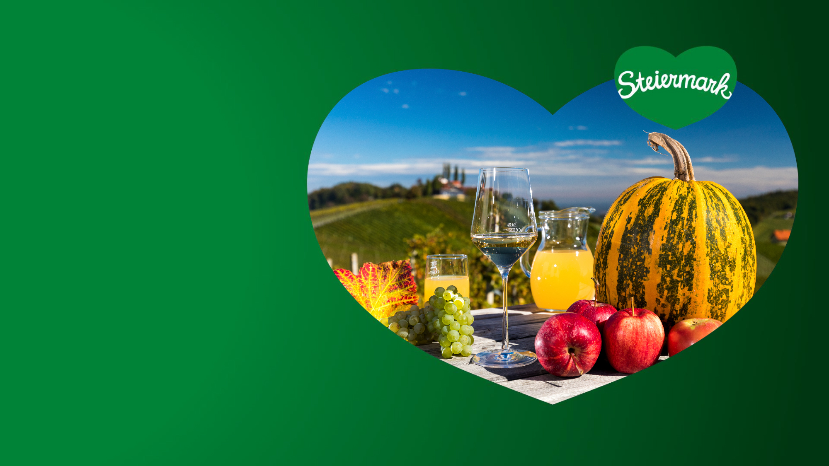
Styria Eating & drinking
A destination with countless culinary highlights
Signature products:
The original pumpkin seed oil
Wine from the famous vineyards of Southern Styria
Apples from south and east Styria
Cheese from the traditional dairies of alpine Upper Styria
steiermark.com/Convention

Slide 8
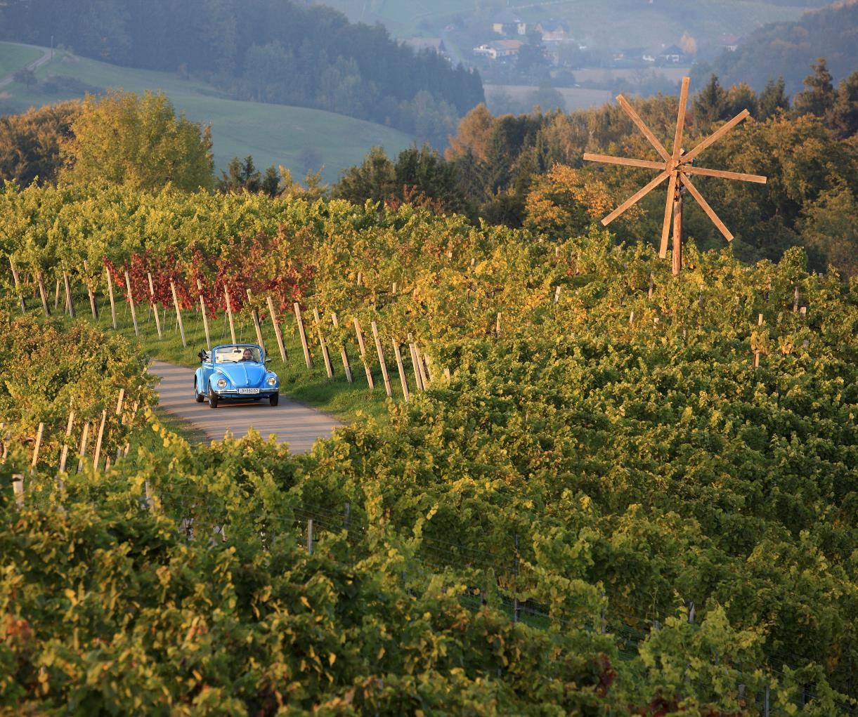
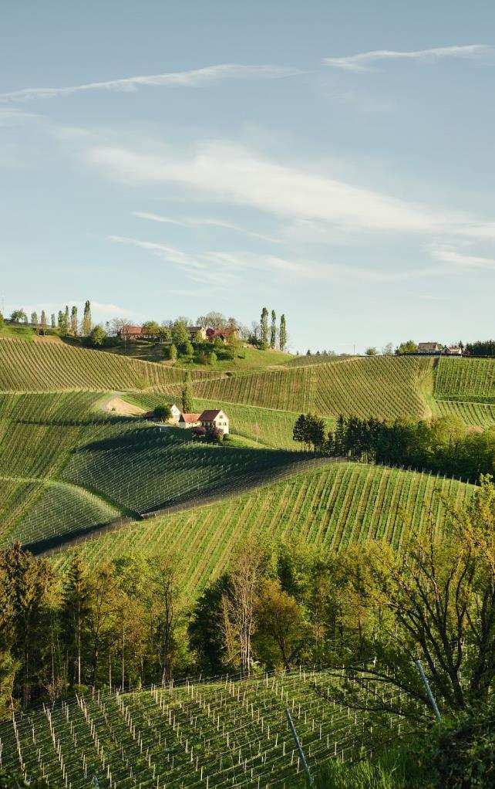
Southern Styria The wine region

Slide 9
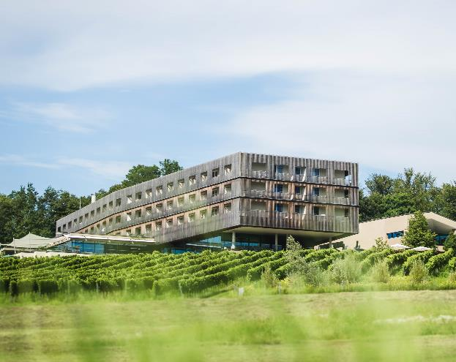
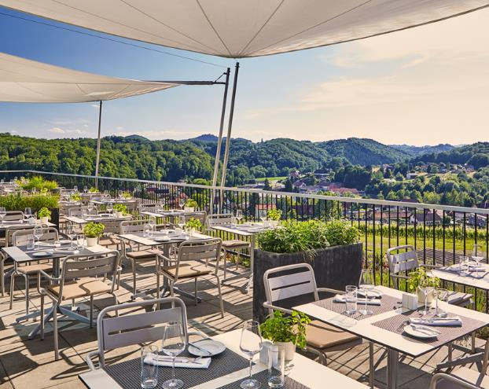
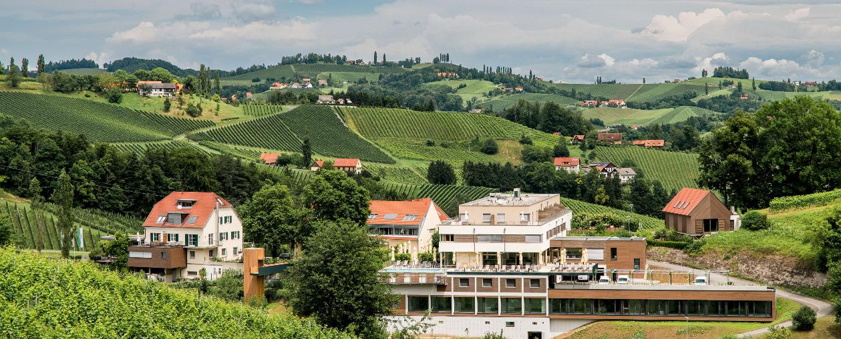
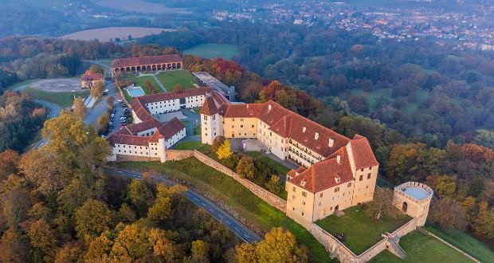

Slide 10
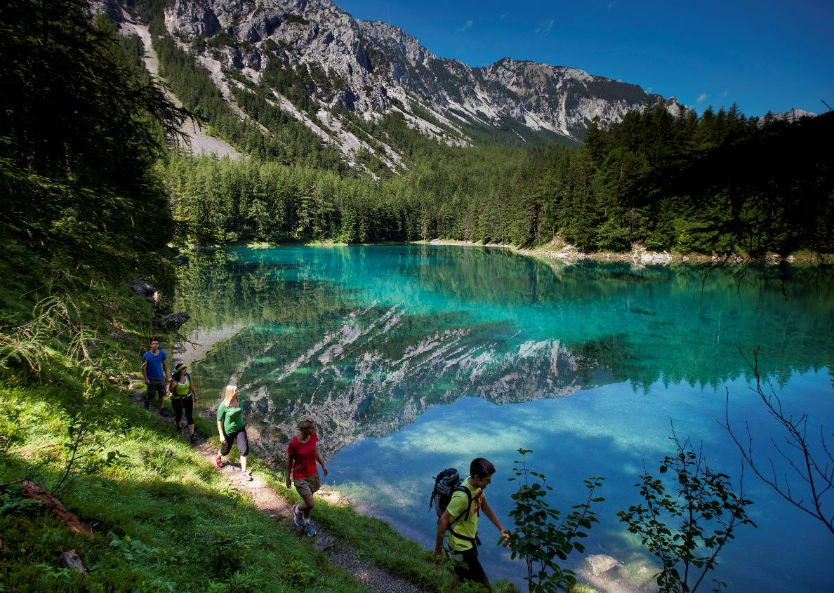
Styria Nature & exercise
Experience nature & activities on mountains, alpine meadows & in forests:
Round off seminar days in breathtaking natural settings, promote team building, recharge your batteries for meetings
Multifaceted in the seasons: From cycling to hiking, from golfing and rafting to cross-country skiing and downhill skiing
Rich landscape from glaciers to wine

Slide 11
Upper Styria The alpine regions

Slide 12
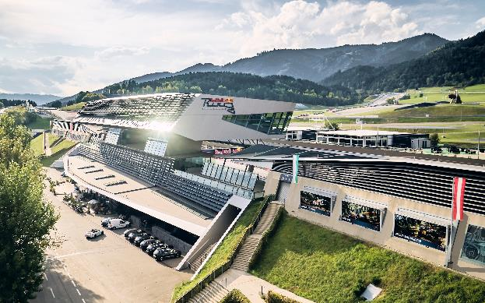
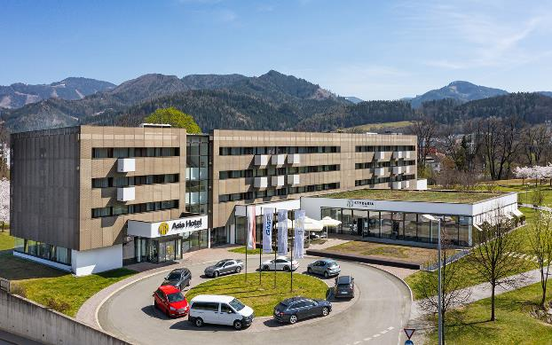
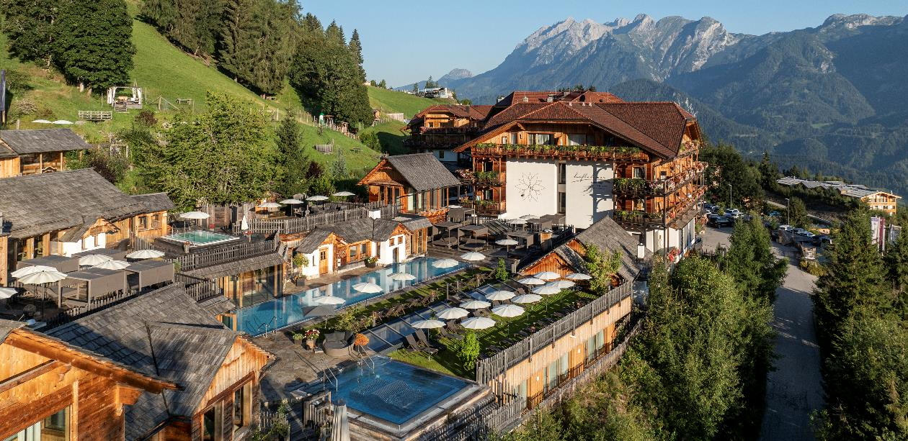
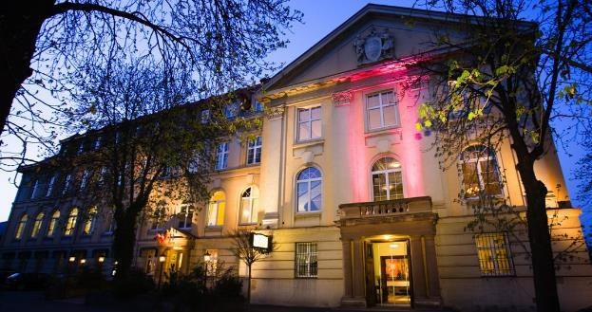

Slide 13
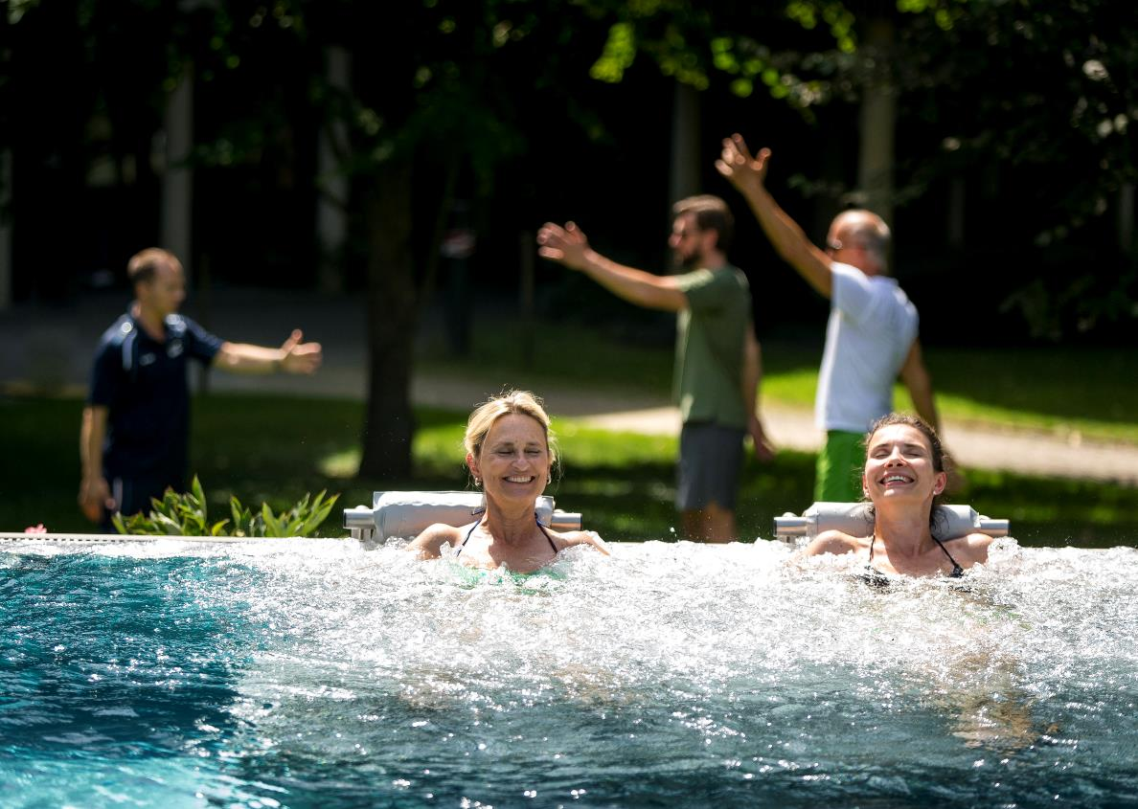
Styria Wellness and regeneration
Styrian thermal springs promise regeneration & wellness for all senses:
Styrian thermal baths and spas offer a wide range of regeneration programmes for conference and congress guests
Well-being: 9 thermal spas and 17 health resorts for relaxation
The power of Styrian product treatments: From grape seeds to volcanic rock
steiermark.com/Convention

Slide 14
Eastern Styria Vulkanland & thermal springs
Schladming-Dachstein The alpine region

Slide 15
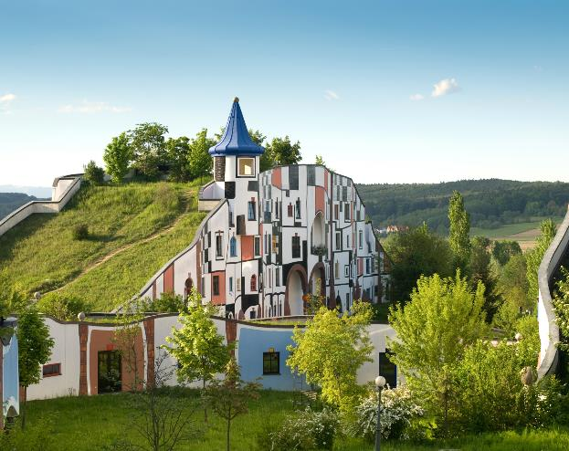
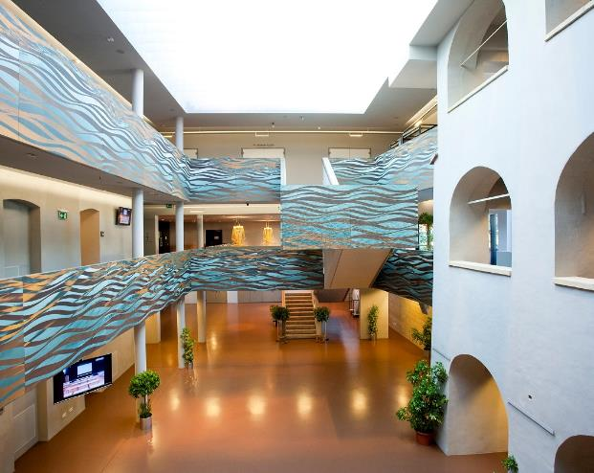
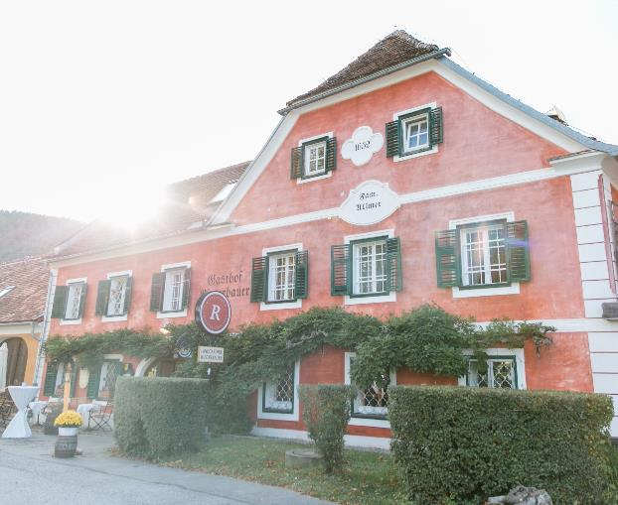
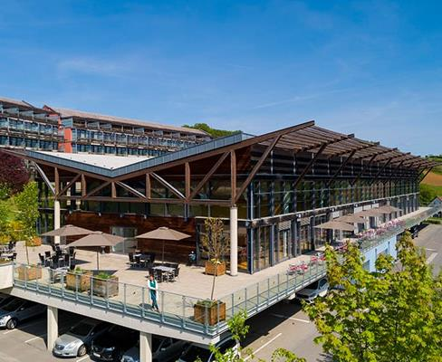
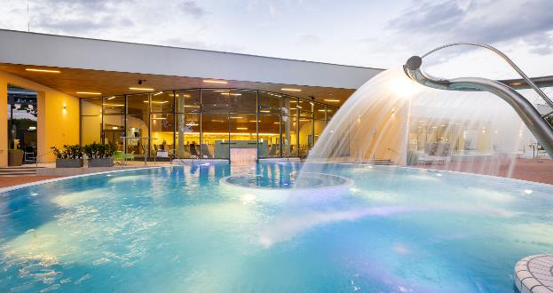

Slide 16
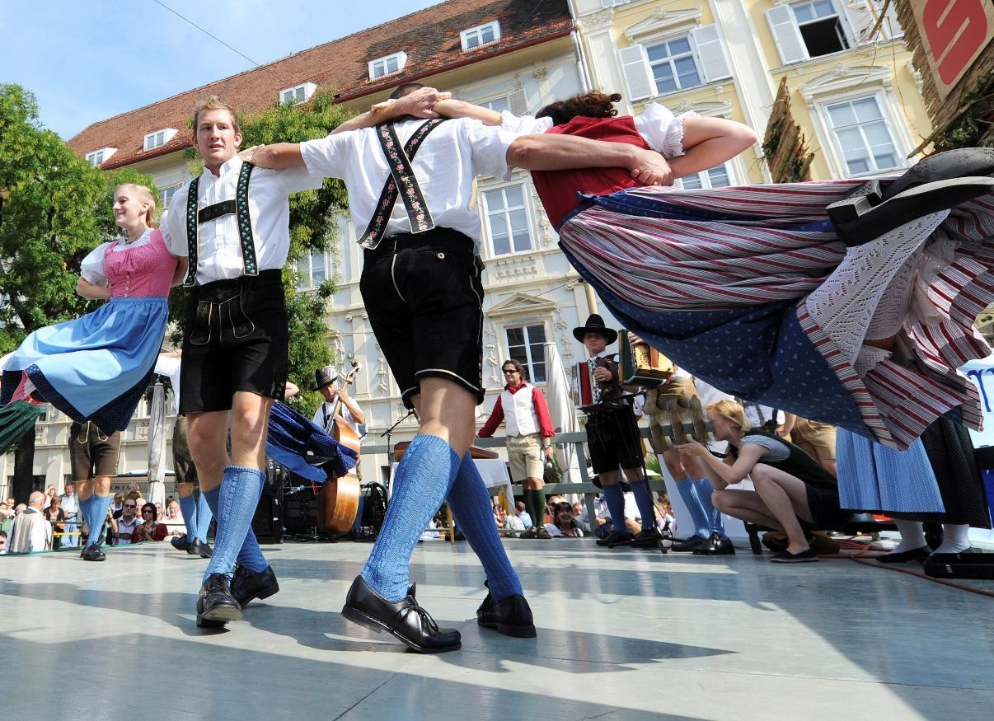
Styria Rich in tradition & culture
Folklore & culture are celebrated in town & country:
Cultural enjoyment as an incentive, company outing or supporting programme
Tradition and customs harmonise with the modern and contemporary
Numerous events such as the Daffodil Festival and cultural highlights from the Lipizzaner horses to the Benedictine Admont Abbey
UNESCO World Heritage Sites and cultural heritage

Slide 17
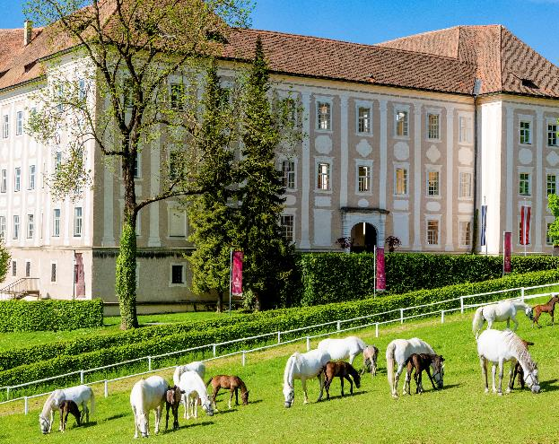
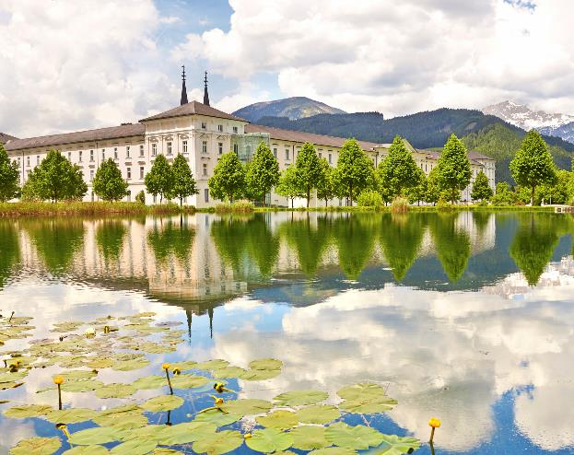
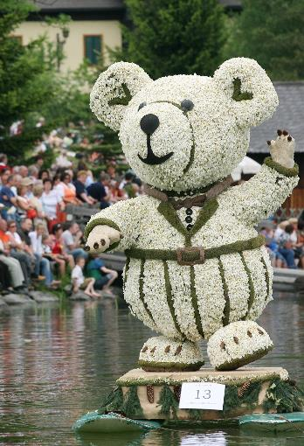
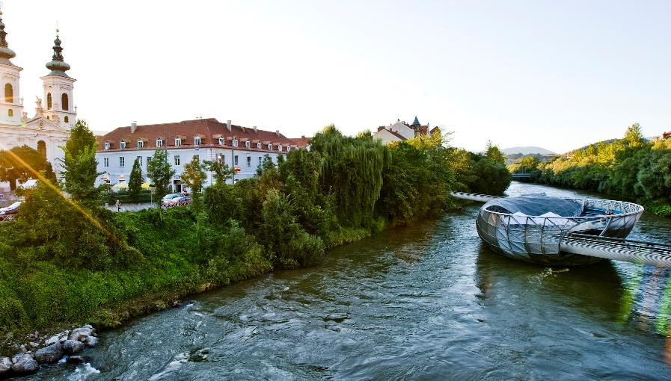
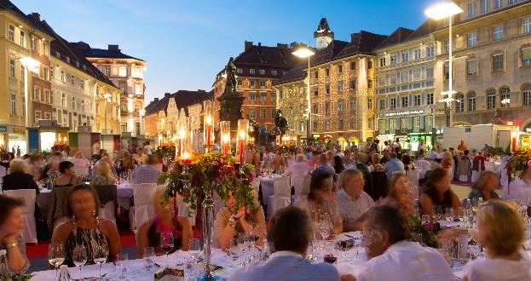

Slide 18
Graz City of Congress & Design
University city (Med Uni, TU, Main University, Joanneum)
3 congress houses (capacities up to 5.000 in one venue)
2 event locations
8 seminar hotels (capacities up to 250 rooms in one house)
steiermark.com/Convention

Slide 19
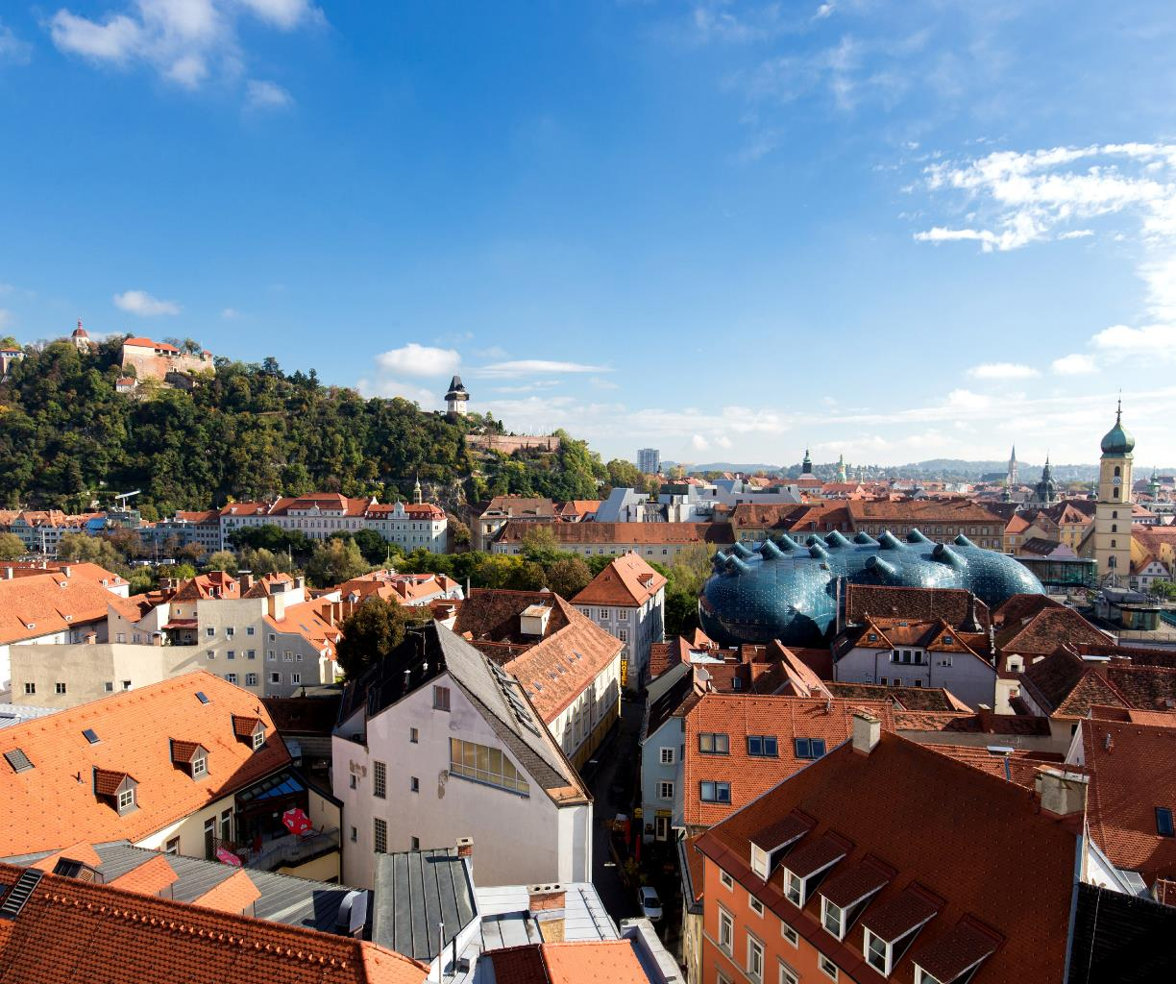
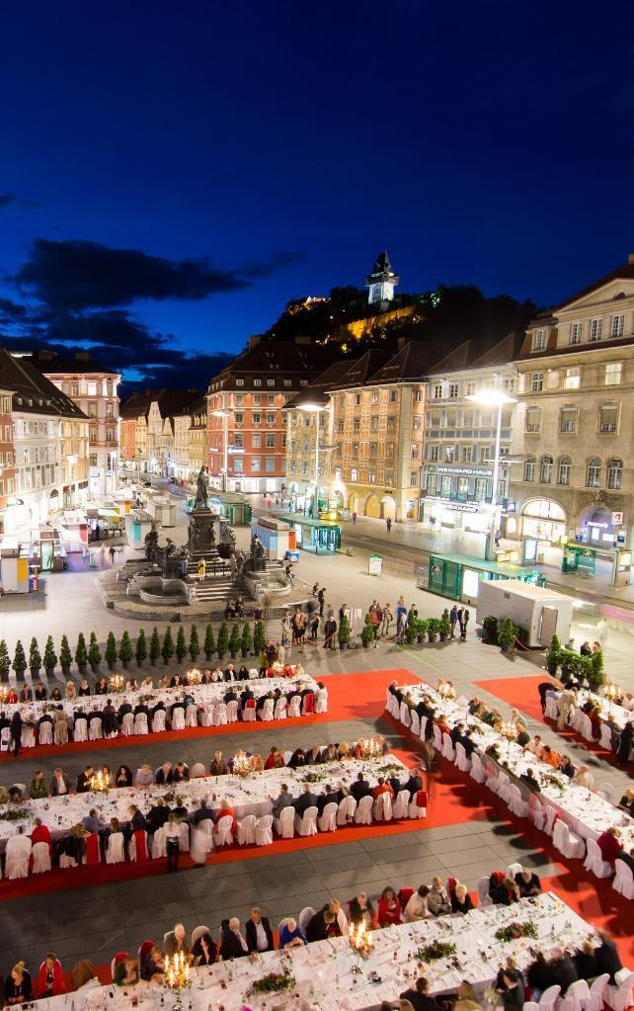
Graz Capital & City of Design

Slide 20
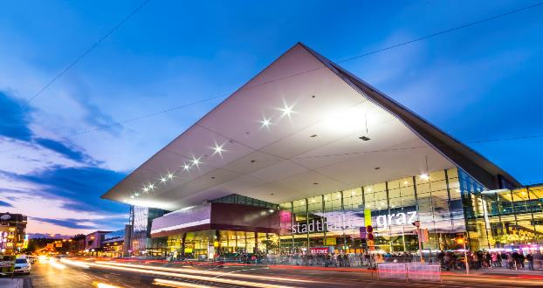
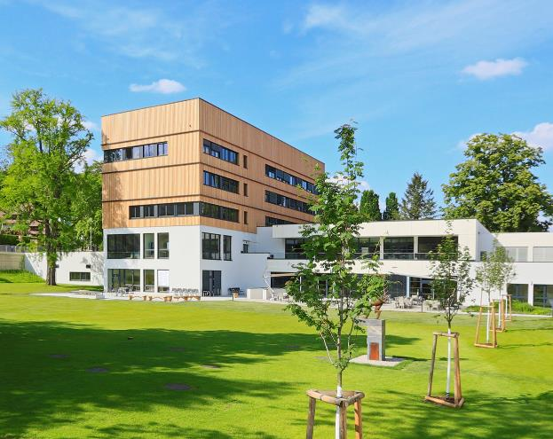
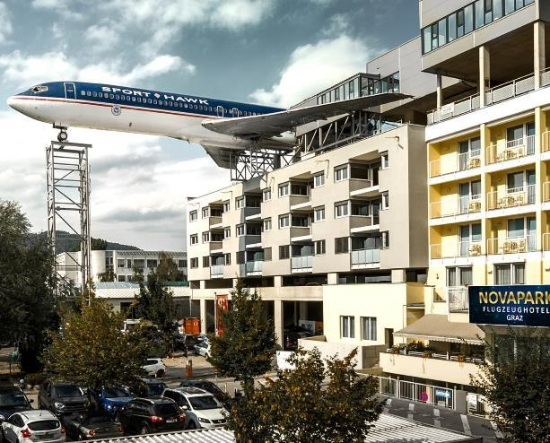
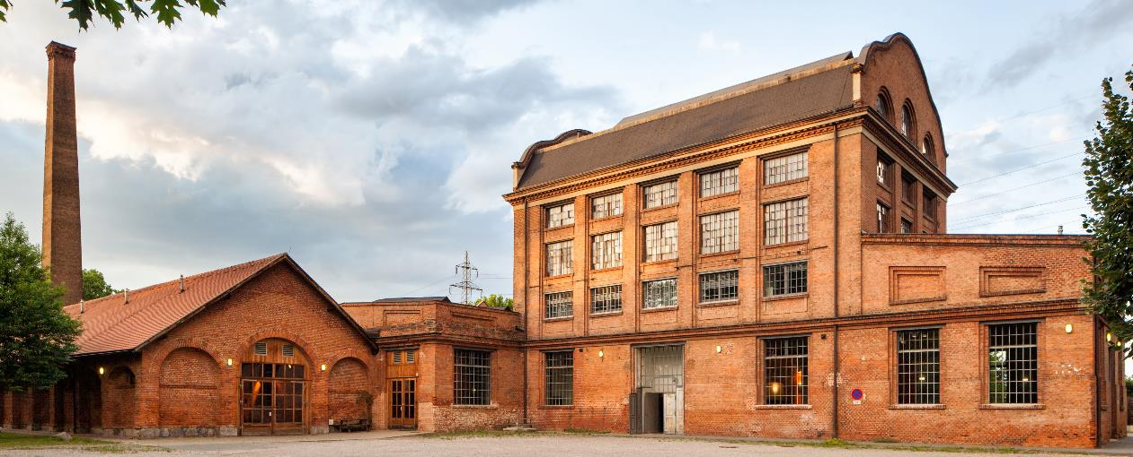
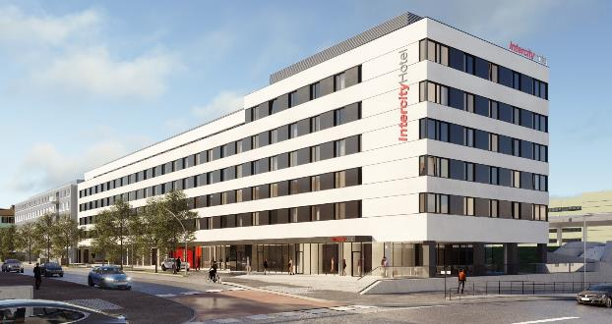

Slide 21
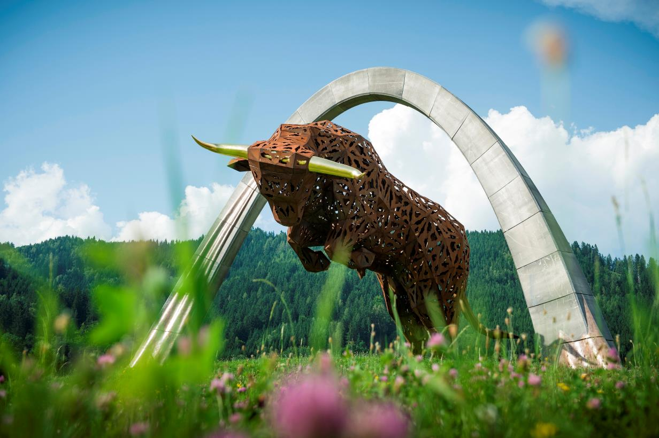
Events Rich in tradition & culture
F1 Austrian Grand Prix & Moto GP Österreich Grand Prix on Red Bull Ring
Night Race FIS Ski World Cup
Dozens of different traditional festivities like Dafodils- or Narzissenfest in Ausseerland, Weinlese in Southern Styria, Aufsteirern in Graz
steiermark.com/Convention

Slide 22
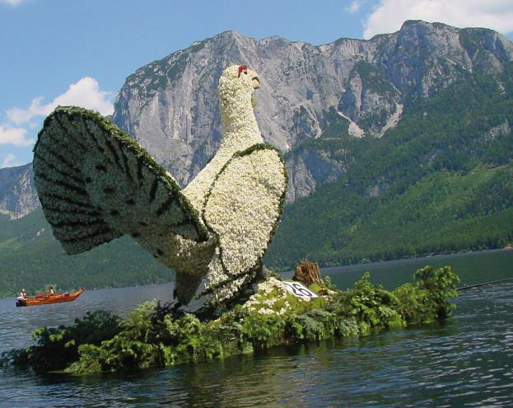
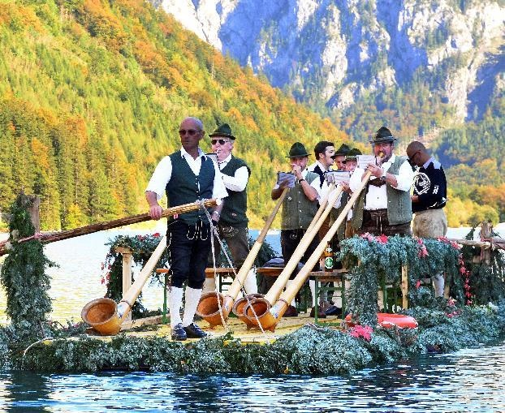
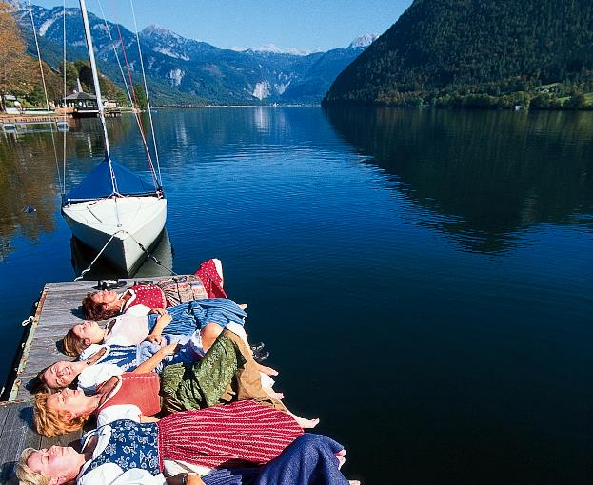
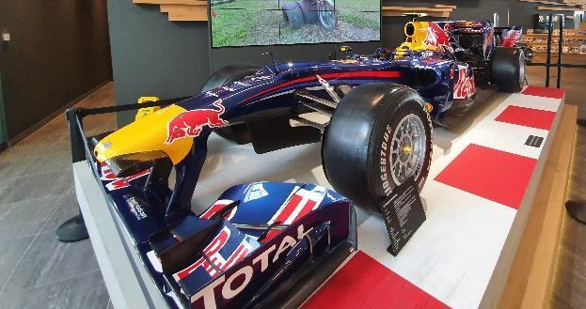

Slide 23
Steiermark Convention Your MICE-partner since 2003
Our free of cost service:
Support in the selection of suitable conference hotels, event locations, congress centres and event agencies
Establishing contact with the providers
Recommendation of incentive ideas, business trips and supporting programme
Online venue finder, tailored to the organiser's requirements
Accompaniment
steiermark.com/Convention

Slide 24
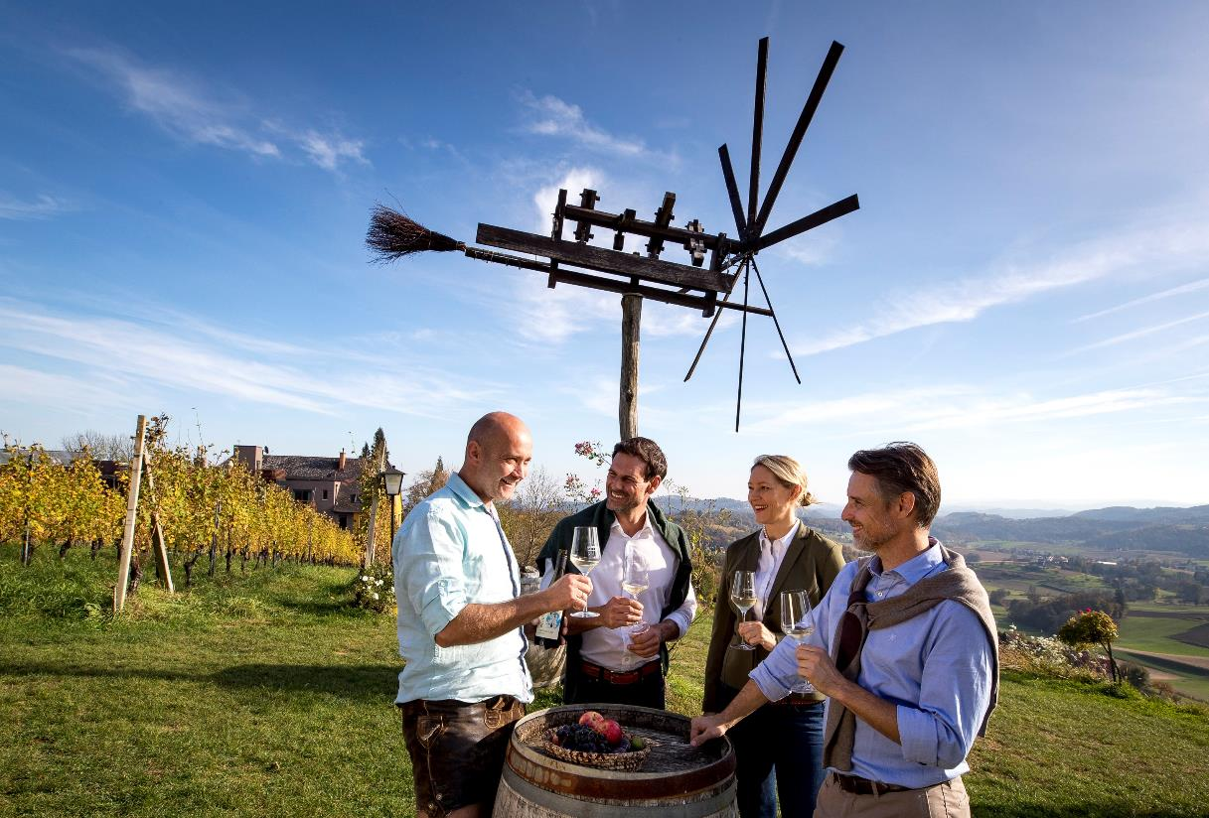
Steiermark Convention Making meetings a delight
See you soon, in The Green Heart of Austria
T: +43 (0) 3112 38585
Mail to: info@steiermark-convention.com
Homepage: steiermark.com/Convention
Instagram: @steiermarkconvention

